Slide 1
Cryptography Unit ‘1’ Introduction and Classical Ciphers
Prepared By: Abhishek Dewan

Slide 2
Computer security
computer security, also called cybersecurity is the protection of computer systems and information from harm, theft, and unauthorized use.
It is the process of preventing and detecting unauthorized use of your computer system.
Computer hardware is typically protected by the same means used to protect other valuable or sensitive equipment—namely, serial numbers, doors and locks, and alarms.
The protection of information and system access, on the other hand, is achieved through other tactics, some of them quite complex.

Slide 3
Types
Information security
Application Security
Network Security
Cybersecurity

Slide 4
Information Security
Information Security is basically the practice of preventing unauthorized access, use, disclosure, disruption, modification, inspection, recording or destruction of information.
Information can be anything like Your details or we can say your profile on social media, your data in mobile phone, your biometrics etc.

Slide 5
Network security
Network security consists of the policies and practices to prevent and monitor unauthorized access, misuse, modification, or denial of a computer network and network-accessible resources.
Also refers to any activity designed to protect the usability and integrity of your network and data.
Network security involves the authorization of access to data in a network, which is controlled by the network administrator.
Network security covers a variety of computer networks, both public and private

Slide 6
It includes both hardware and software technologies.
Effective network security manages access to the network.
It targets a variety of threats and stops them from entering or spreading on your network.

Slide 7
Types of network security
Access control
To keep out potential attackers, system needs to recognize each user and each device.
Then it can enforce security policies.
Block noncompliant endpoint devices or give them only limited access.

Slide 8
Antivirus software
install antivirus applications to protect the systems from harmful softwares.
regularly updating the antivirus software helps to add and identify new virus definitions.

Slide 9
Application security
Any application may contain holes, or vulnerabilities, that attackers can use to infiltrate the network.
Application security encompasses the hardware, software, and processes you use to close those loop holes.

Slide 10
Behavioral analytics
To detect abnormal network behavior, system must know what normal behavior looks like.
Behavioral analytics tools automatically discern activities that deviate from the norm.
Security team can then better identify indicators of compromise that pose a potential problem.

Slide 11
Data loss prevention
Data loss can occour from system due to various reasons.
Critical data might loss or get corrupted from the system due to virus, bus or third party attacks.
System should have provisions to tackle such data losses.

Slide 12
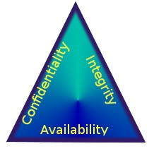
CIA triad

Slide 13
Confidentiality, integrity and availability, also known as the CIA triad, is a model designed to guide policies for information security within an organization.
The model is also sometimes referred to as the AIC triad.
The elements of the triad are considered the three most crucial components of security.

Slide 14
Confidentiality
Confidentiality is roughly equivalent to privacy.
Measures undertaken to ensure confidentiality are designed to prevent sensitive information from reaching the wrong people, while making sure that the right people can in fact get it.
Data encryption is a common method of ensuring confidentiality.

Slide 15
Integrity
Integrity involves maintaining the consistency, accuracy, and trustworthiness of data over its entire life cycle.
Data must not be changed in transit,

Slide 16
Steps must be taken to ensure that data cannot be altered by unauthorized people.
These measures include file permissions and user access controls.

Slide 17
Availability
Availability is best ensured by rigorously maintaining all hardware.
Performing hardware repairs immediately when needed and maintaining a correctly functioning operating system environment that is free of software conflicts.

Slide 18
It’s also important to keep up with all necessary system upgrades.
Providing adequate communication bandwidth and preventing the occurrence of bottlenecks are equally important.

Slide 19
Network Security Attack Types :
Passive Attacks
Active Attacks

Slide 20
Passive Attacks
The first type of attack is passive attack.
A passive attack can monitor, observe or build use of the system’s data for sure functions.
However, it doesn’t have any impact on the system resources, and also, the data can stay unchanged.

Slide 21
The victim is difficult to note passive attacks as this sort of attack is conducted in secret.
Passive attack aims to achieve data or scan open ports and vulnerabilities of the network.

Slide 22
Passive Attack Examples
Eavesdropping
An eavesdropping attack is taken into account as a kind of passive attack.
An eavesdropping attack is to steal data transmitted among two devices or users that are communicating.

Slide 23
Traffic analysis is enclosed in eavesdropping.
An eavesdropping attack happens once the attackers insert a software package within the network path to capture future network traffic.

Slide 24
Release of messages
The release of messages is additionally another kind of passive attack.
The attackers install a package to the device by using virus or malware to watch the device’s activities like a conversation of messages, emails, or any transferred files that contain personal information and knowledge.
The attackers will use the data to compromise the device or network.

Slide 25
Assignment : Research about the following attacks
Some other Passive Attacks:
Wiretapping
Port scanner

Slide 26
Active Attacks
An active attack could be a network exploit during which the attackers will modify or alter the content and impact the system resource.
an intruder initiates commands to disrupt the network's normal operation or gain access to assets available via the network.

Slide 27
It’ll cause damages to the victims.
The attackers can perform passive attacks to gather info before they begin playacting a vigorous attack.
The attackers attempt to disrupt and forced the lock of the system.
The victims can get informed concerning the active attack.
This sort of attack can threaten their integrity and accessibility.

Slide 28
Denial-of-Service
Denial-of-Service attacks (DoS) are one in each of the samples of active attack.
A denial-of-Service attack happens once the attackers take action to close up a system or network.
This may cause the user to be unable to access the actual device or network.

Slide 29
The attackers can flood the target device or network with traffic till it’s not responding or flaming.
The services that are affected are emails, websites.

Slide 30
DNS spoofing
Domain Name Server (DNS) spoofing (a.k.a. DNS cache poisoning) is an attack in which altered DNS records are used to redirect online traffic to a fraudulent website that resembles its intended destination.

Slide 31
Once there, users are prompted to login into (what they believe to be) their account, giving the perpetrator the opportunity to steal their access credentials and other types of sensitive information.
Furthermore, the malicious website is often used to install worms or viruses on a user’s computer, giving the perpetrator long-term access to it and the data it stores.

Slide 32
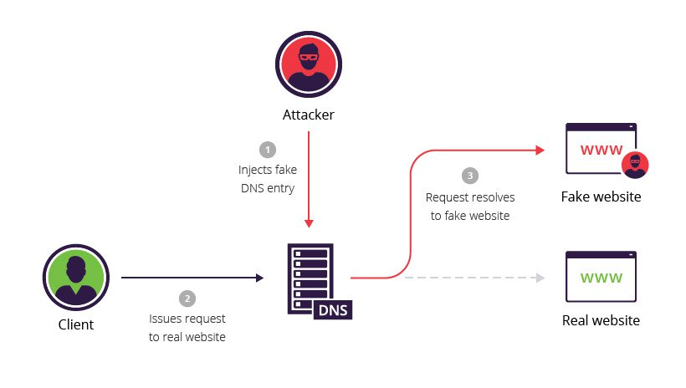

Slide 33
Assignment : Research about the following attacks
Other Active Attacks:
SQL injection
Phishing

Slide 34
Cryptography
The word cryptography comes from two Greek words meaning “secret writing” and is the art and science of information hiding.
This field is very much associated with mathematics and computer science with application in many fields like computer security, electronic commerce, telecommunication, etc.

Slide 35
Cryptanalysis
Cryptanalysis is the breaking of codes.
Cryptanalysis encompasses all of the techniques to recover the plaintext and/or key from the ciphertext.
The combined study of cryptography and cryptanalysis is known as cryptology.

Slide 36
Encryption and Decryption
Encryption is the process of encoding a message so that its meaning is not obvious i.e. converting information from one form to some other unreadable form using some algorithm called cipher with the help of secret component called key.
The converting text is called is plaintext and the converted text is called ciphertext.

Slide 37
Decryption
Decryption is the reverse process, transforming an encrypted message back into its normal, original form.
In decryption process also the use of key is important.

Slide 38
Alternatively, the terms encode and decode or encipher and decipher are used instead of encrypt and decrypt.
That is, we say that we encode, encrypt, or encipher the original message to hide its meaning.
Then, we decode, decrypt, or decipher it to reveal the original message.

Slide 39


Slide 40
Key
A key is a parameter or a piece of information used to determine the output of cryptographic algorithm.
While doing the encryption, key determines the transformation of plaintext to the cipher text and vice versa.
Keys are also used in other cryptographic processes like message authentication codes and digital signatures.
Most of the cryptographic systems depend upon the key and thus the secrecy of the key is very important.

Slide 41
Another important issue for the key is its length.
Since key is the sole entity that defines the strength of the security (normally algorithm used is public) we need to select the key in a way such that attacker should take long enough to try all possibilities.
To prevent the key from being guessed the choice of the key must be random.

Slide 42
Cipher
A cipher is an algorithm for performing encryption and decryption.
The operation of cipher depends upon the special information called key.
Without knowledge of the key, it should be difficult, if not nearly impossible, to decrypt the resulting cipher into readable plaintext.

Slide 43
Cryptosystem
Cryptosystem is a 5-tuple/quintuple (E, D, M, K, C), where M set of plaintexts, K set of keys, C set of ciphertexts, E set of encryption functions:
e: M x K = C and
D set of decryption functions :
d: C x K = M.

Slide 44
Classical Cryptosystem
Historical pen and paper ciphers used in the past are sometimes known as classical ciphers.
These are the very old or quite old cryptosystem that were used in pre computer age.
These crypto system are too weak now days and can be broken easily with computer.

Slide 45
Substitution Cipher
In substitution ciphers the letters are systematically replaced by other letters or symbols.
The letters are replaced based on the given key value.

Slide 46
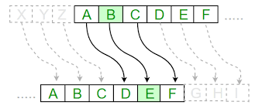
Type of Substitution Cipher: Caesar Cipher
It is the simple shift monoalphabetic classical cipher where each letter is replaced by a letter 3 position (actual Caesar cipher) ahead using the circular alphabetic ordering i.e. letter after Z is A.

Slide 47
Here we number each English alphabet starting from 0 (A) to 25 (Z).
Each letter of the clear message is replaced by the letter whose number is obtained by adding the key (a number from 0 to 25) to the letter's number modulo 26.

Slide 48
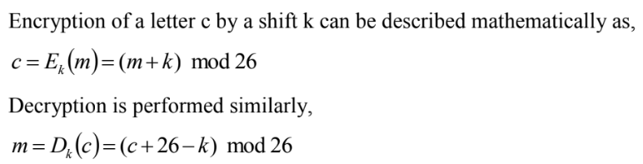

Slide 49
Example:
Plaintext = “CAT” Key = “3”
For C,
Ciphertext = (m+k) mod 26
= (2+3) mod 26
= 5 = F
For A,
Ciphertext = (m+k) mod 26
= (0+3) mod 26
= 3 = D
For T,
Ciphertext = (m+k) mod 26 Therefore,
= (20+3) mod 26 Ciphertext of CAT is FDW
= 23 = W

Slide 50
??Classwork
Using Caesar Cipher, encrypt the following plaintext:
plaintext= “he is a cop”, key = 23
plaintext= “he is the murderer”, key = 17
Using Caesar Cipher, decrypt the following ciphertext:
ciphertext= “RHXI”, key = 15

Slide 51
Attacking the Cipher
Caesar Cipher is quite easily broken even with ciphertext only.
One can attack the cipher text using exhaustive search by trying all possible keys until you find the right one.
Exhaustive search is best suited if the key space is small and we have only 26 possible keys main problem with Caesar’s Cipher is that the key is too short and can be found by exhaustive search.

Slide 52
Transposition Cipher
In transposition ciphers the letters are systematically arranged so that the actual position of letters gets changed making the text garble.

Slide 53
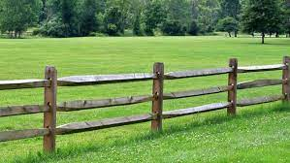
Type of Transposition Cipher: Rail-Fence Cipher
The Rail Fence Cipher is a form of transposition cipher that derives its name from the way in which it is encoded.
The plain text is written in a specific pattern in the fences of the rail.

Slide 54
Encryption
Firstly, you need to have a key, which for this cipher is the number of rows you are going to have the plaintext is written downwards and diagonally on successive "rails" of an imaginary fence, then moving up when we reach the bottom rail.
When we reach the top rail, the message is written downwards again until the whole plaintext is written out.
The message is then read off in rows.

Slide 55

For example, the plaintext "defend the east wall" is written as shown below, with all spaces removed.
The ciphertext is then read off by writing the top row first, followed by the bottom row, to get DFNTEATALEEDHESWL.

Slide 56

For the plaintext we used above, "defend the east wall", with a key of 3, we get the encryption process shown below.
The Rail Fence Cipher with a key of 3, the nulls(“X”) added at the end of the message to make it the right length.
The ciphertext is read off row by row to get DNETLEEDHESWLXFTAAX

Slide 57
??Classwork
Using rail fence, encrypt the following plaintext:
plaintext= “the gun is under the table”, key = 3
plaintext= “the gun is under the table”, key = 4

Slide 58
Decryption
The decryption process for the Rail Fence Cipher involves reconstructing the diagonal grid used to encrypt the message.
Start writing the message, but leaving a dash in place of the spaces yet to be occupied.
Gradually, replace all the dashes with the corresponding letters, and read off the plaintext from the table.

Slide 59
Start by making a grid with as many rows as the key is, and as many columns as the length of the ciphertext.
We then place the first letter in the top left square, and dashes diagonally downwards where the letters will be.
When we get back to the top row, we place the next letter in the ciphertext.
Continue like this across the row, and start the next row when you reach the end.

Slide 60

Example:
ciphertext = TEKOOHRACIRMNREATANFTETYTGHH
Step 1: We draw a table with 4 rows because the key is 4, and 28 columns as the ciphertext has length 28.

Slide 61


Step 2:
Step 3:

Slide 62

Step 4:
From this we can now read the plaintext off following the diagonals to get "they are attacking from the north".

Slide 63
??Classwork
Using rail fence, decrypt the following ciphertext:
ciphertext= “BOOIGXUYUBOSNUUTYRKAS”, key = 3
Ciphertext= “ASNODANETISOTNMVNEMEGWFBAOGSWEREIHALVNSBTLI”, key = 5
Ciphertext= “EOCSNYUWLEJYREASONS”, key = 4

Slide 64
No: b Solution:
A |  |  |  |  |  |  |  | S |  |  |  |  |  |  |  | N |  |  |  |  |  |  |  | O |  |  |  |  |  |  |  |  | D |  |  |  |  |  |  |  | A
 | N |  |  |  |  |  | E |  | T |  |  |  |  |  | I |  | S |  |  |  |  |  | O |  | T |  |  |  |  |  |  | N |  | M |  |  |  |  |  | V |  | N
 |  | E |  |  |  | M |  |  |  | E |  |  |  | G |  |  |  | W |  |  |  | F |  |  |  | B |  |  |  | A |  |  |  |  | O |  |  |  | G |  |  |  | S
 |  |  | W |  | E |  |  |  |  |  | R |  | E |  |  |  |  |  | I |  | H |  |  |  |  |  | A |  | L |  |  |  |  |  |  | V |  | N
 |  |  |  | S |  |  |  |  |  |  |  | B |  |  |  |  |  |  |  | T |  |  |  |  |  |  |  | L |  |  |  |  |  |  |  |  | I

Slide 65
Monoalphabetic Cipher v/s Polyalphabetic Cipher
Monoalphabetic Cipher : A monoalphabetic cipher is any cipher in which the letters of the plain text are mapped to cipher text letters based on a single alphabetic key.
Examples of monoalphabetic ciphers would include the Caesar-shift cipher, where each letter is shifted based on a numeric key, and the atbash cipher, where each letter is mapped to the letter symmetric to it about the center of the alphabet.

Slide 66
Polyalphabetic Cipher :
A polyalphabetic cipher is any cipher based on substitution, using multiple substitution alphabets.
The Vigenère cipher is probably the best-known example of a polyalphabetic cipher, though it is a simplified special case.

Slide 67
Vigenere Cipher
It is like Caesar cipher, but uses a phrase or alphabet for key.
It is a polyalphabetic cipher.
It is a type of substitution cipher.
It uses a table called Vignere Table for both encryption and decryption process.

Slide 68
Encryption
Before encryption, repeat the keyword as long as the length of the plaintext.
Use the Vignere table for encryption.
The plaintext characters are across the row and key characters are across the column of the table.
Match the plaintext and key character and select the appropriate ciphertext character from table.

Slide 69

PLAINTEXT
KEY

Slide 70
Example:
plaintext THEBOYHASTHEBALL
key VIGVIGVIGVIGVIGV
ciphertext OPKWWECIYOPKWIRG

Slide 71
???Classwork
Create a Vignere Table from column E-O, and encrypt the plaintext “HELLO” with key “GHI”
Encrypt the plaintext “THEY ARE ATTACKING ON MONDAY” with key “GUN”
Decrypt the ciphertext “BHFBDYFIFDDFTWPFOH” with key “BOMB”
Decrypt the ciphertext “YYVJOAUYETIIVLPFJ” with key “RUN”

Slide 72

One-Time Pad
It is a variant of a Vigenère cipher with a random key everytime.
He suggested using a random key, so the key need not be repeated.
The "pad" part of the name comes from early implementations where the key material was distributed as a pad of paper, so that the top sheet could be easily torn off and destroyed after use.

Slide 73
For ease of concealment, the pad was sometimes reduced to such a small size that a powerful magnifying glass was required to use it.
the key is to be used to encrypt and decrypt a single message, and then is discarded.

Slide 74
Vernam Cipher
Vernam Cipher is a type of substitution cipher.
Like Caesar cipher, in this mechanism we assign a number to each character of the Plain-Text and Key, like (a = 0, b = 1, c = 2, … z = 25)

Slide 75
Encryption
Assign a number to each character of the plain-text and the key according to alphabetical order.
Add both the number corresponding Plain-text character and Key character.
Perform Modular operation or Subtract 26 from the number if the added number is greater than 26, if it isn’t then leave it.

Slide 76
Example:
Plain-Text: RUPK
Key: BABA
Now according to our encryption algorithm we assign a number to each character of our plain-text and key.
PT: R U P K
NO: 17 20 15 10

Slide 77
KEY: B A B A
NO: 1 0 1 0
Now add the number of Plain-Text and Key, then we will get the corresponding Cipher-Text character number.
CT-NO: 18 20 16 10
CIPHER-TEXT: S U Q K

Slide 78
??Classwork
Using Vernam Cipher, Encrypt the following using given key:
Plaintext = GUN IS UNDER THE TABLE Key = REVOLVER
Using Vernam Cipher, Decrypt the following using given key:
Ciphertext = UVQZBFQVTWZHOIOMFODXFOBPO Key = BOMB

Slide 79
Playfair Cipher
The Playfair cipher encrypts pairs of letters (digraphs), instead of single letters as is the case with simpler substitution ciphers
Frequency analysis is still possible on the Playfair cipher, however it would be against 600 possible pairs of letters instead of 26 different possible letters.

Slide 80
The playfair cipher starts with creating a key table.
The key table is a 5×5 grid/matrix of letters that will act as the key for encrypting your plaintext.
Each of the 25 letters must be unique and two letters of the alphabet (usually I&J) is placed in the same box as there are only 25 spots.

Slide 81
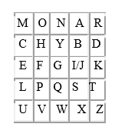
5 x 5 matrix of letters is constructed using the given keyword.
For example the given keyword is “MONARCHY”, the 5 x 5 matrix will look like below:

Slide 82
The matrix is constructed by filling in the letters of the keyword (minus duplicates) from left to right and from top to bottom, and then filling with the remaining letters in alphabetic order in the remainder of the matrix.

Slide 83
??Classwork
Create a PlayFair Matrix with the given keywords :
“AEROPLANE”
“ALCOHOLIC”

Slide 84
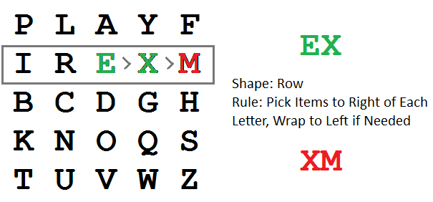
Encryption:
Plaintext is encrypted two letters at a time, according to the following rules:
Repeating plaintext letters that are in the same pair are separated with a filler letter, such as x, so that balloon would be treated as ba lx lo on.
While creating digraphs, if there are single character left at the end, then also pair it with the filler letter.
Two plaintext letters that fall in the same row of the matrix are each replaced by the letter to the right, with the first element of the row circularly following the last.

Slide 85
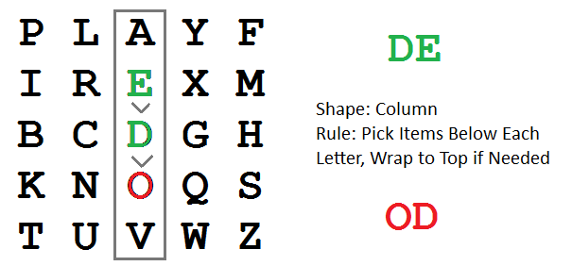
Two plaintext letters that fall in the same column are each replaced by the letter beneath, with the top element of the column circularly following the last.

Slide 86
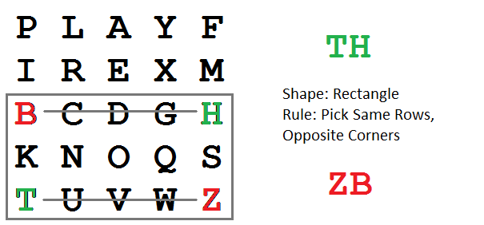
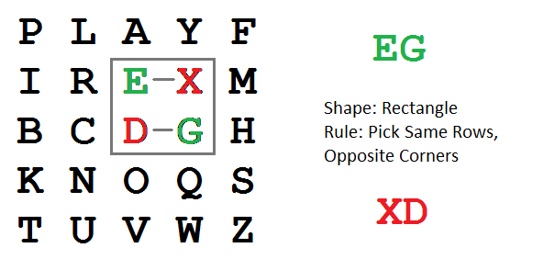
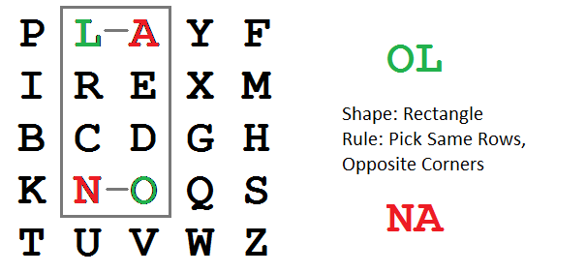
Otherwise, form a rectangle with the two letters and take the letters on the horizontal opposite corner of the rectangle.

Slide 87
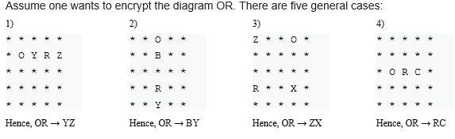

Slide 88
??Classwork
Using Playfair Cipher, Encrypt the following creating Playfair matrix using given key:
Plaintext = THEY ARE TERRORIST Key = REVOLVER
Using Playfair Cipher, Encrypt the following creating Playfair matrix using given key:
Plaintext = THEY WANT TO ATTACK PRESIDENT
Key = BIDEN

Slide 89
Using Playfair Cipher, Decrypt the following creating Playfair matrix using given key:
Plaintext = NAANDIBPCGKQCTYL
Key = TANGO

Slide 90
The Hill Cipher
Like the other Digraphic Ciphers it acts on groups of letters(digraphs).
Unlike the others though it is extendable to work on different sized blocks of letters.
So, technically it is a polygraphic substitution cipher, as it can work on digraphs, trigraphs (3 letter blocks) or theoretically any sized blocks.

Slide 91
The Hill Cipher uses an area of mathematics called Linear Algebra, and in particular requires the user to have an elementary understanding of matrices.
It also make use of Modulo Arithmetic
this, the cipher has a significantly more mathematical nature than some of the others.

Slide 92
Requires a much deeper knowledge of the background mathematics.
Some important concepts are used throughout: Matrix Multiplication; Modular Inverses; Determinants of Matrices; Matrix Adjugates (for finding inverses).

Slide 93
Encryption
To encrypt a message using the Hill Cipher we must first turn keyword into a key matrix (a 2 x 2 matrix for working with digraphs, a 3 x 3 matrix for working with trigraphs, etc).
Also turn the plaintext into digraphs (or trigraphs) and each of these into a column vector.
We then perform matrix multiplication modulo the length of the alphabet (i.e. 26) on each vector.
These values are then converted back into letters to produce the ciphertext.

Slide 94
Example (2x2 matrix)
Plaintext : "short example“
Keyword : HILL
The first step is to turn the keyword into a matrix.
If the keyword is longer than the 4 letters needed, we would only take the first 4 letters, and if it was shorter, we would fill it up with Filler Letter.

Slide 95


The keyword matrix:
Convert this into a key matrix. We do this by converting each letter into a number by its position in the alphabet (starting at 0). So, A = 0, B = 1, C= 2, D = 3, etc.

Slide 96


Now, split the plaintext into digraphs, and write these as column vectors.
Now convert the plaintext column vectors in the same way that we converted the keyword into the key matrix.

Slide 97


multiply the key matrix by each column vector

Slide 98


Perform modulo 26 operation:

Slide 99



Slide 100




Slide 101
??Classwork
Using Hill Cipher, Encrypt the following using given key:
Plaintext = BOMB IS AT TEKU Key = HELL
Using Hill Cipher, Encrypt the following using given key:
Plaintext = THE TARGET IS KING Key = MOON

Slide 102
Decryption
To decrypt a ciphertext encoded using the Hill Cipher, we must find the inverse key matrix.
That is we multiply the inverse key matrix by the column vectors of the ciphertext, take the results modulo the length of the alphabet, and finally convert the numbers back to letters.

Slide 103

In general, to find the inverse of the key matrix, we perform the calculation below,
where K is the key matrix, d is the determinant of the key matrix and adj(K) is the adjugate matrix of K.

Slide 104
Example (2x2 matrix)
We shall decrypt the example above, so we are using the keyword HILL and our ciphertext is "APADJ TFTWLFJ“
writing out the keyword as a matrix and converting this into a key matrix =

Slide 105


Step 1 - Find the Multiplicative Inverse of the Determinant
First calculate determinant:

Slide 106
Now have to find the modular multiplicative inverse of the determinant working modulo 26.
That is, the number between 1 and 25 that gives an answer of 1 when we multiply it by the determinant.
So, in this case, we are looking for the number that we need to multiply 15 by to get an answer of 1 modulo 26.

Slide 107


it is often easiest to use trial and error to find the inverse.
If d is the determinant, then we are looking for the inverse of d.

Slide 108

So the multiplicative inverse of the determinant(15) modulo 26 is 7.

Slide 109


Step 2 - Find the Adjugate Matrix

Slide 110


Step 3 - Multiply the Multiplicative Inverse of the Determinant by the Adjugate Matrix

Slide 111
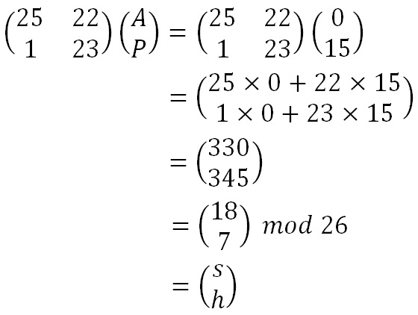
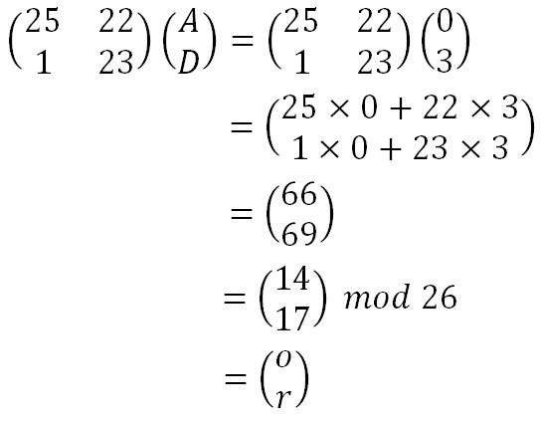
Convert the ciphertext into column vectors and multiply the inverse matrix by each column vector.

Slide 112
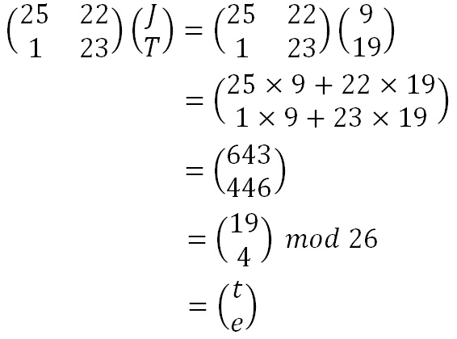
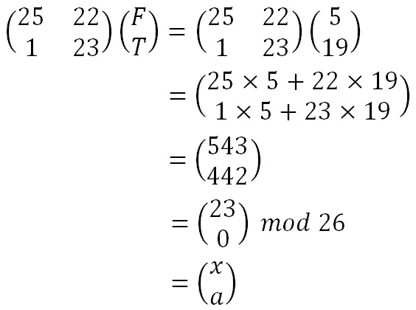

Slide 113
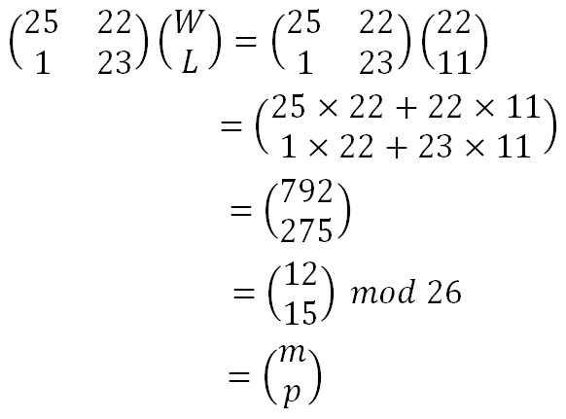
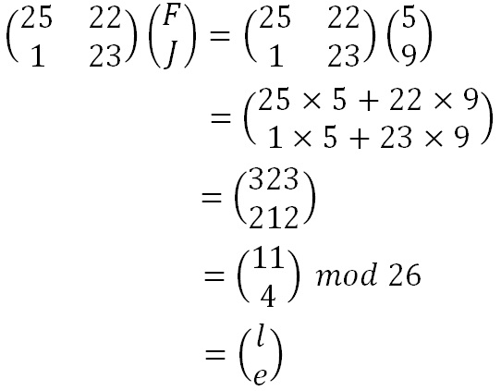

Slide 114
??Classwork
Using Hill Cipher, Decrypt the previous cipher text using the same given key.

Slide 115
Types of Substitution Ciphers:
Monoalphabetic Ciphers
Once a key is chosen, each alphabetic character of a plaintext is mapped onto a unique alphabetic character of a ciphertext.
Each character of a plain text is mapped to a fixed other character of cipher text.
Example: The Shift Cipher (Caesar Cipher)

Slide 116
Polyalphabetic Ciphers
Each alphabetic character of a plaintext can be mapped onto ‘m’ alphabetic characters of a ciphertext.
a plaintext can be mapped into more than one possible characters in ciphertexts.
Example: Vignere cipher, Playfair cipher

Slide 117
Types of Modern Ciphers:
Based on working:
Stream cipher
A stream cipher is an encryption algorithm that encrypts 1 bit or byte of plaintext at a time.
It uses an infinite stream of pseudorandom bits as the key.
Poplular stream ciphers: RC4

Slide 118
Block cipher
A block cipher is an encryption algorithm that encrypts a fixed size of n-bits of data - known as a block - at one time.
The usual sizes of each block are 64 bits, 128 bits, and 256 bits.
So for example, a 64-bit block cipher will take in 64 bits of plaintext and encrypt it into 64 bits of ciphertext.
Poplular block ciphers: DES, 3DES, AES, BLOWFISH

Slide 119
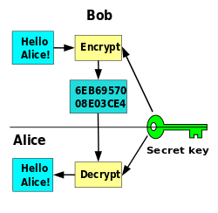
Based on type of key used:
1) Symmetric-key cryptography / Private Key Cryptography

Slide 120
In Symmetric-key cryptography, where a single key is used for encryption and decryption.
Symmetric-key cryptography refers to encryption methods in which both the sender and receiver share the same key.
the only kind of encryption publicly known until June 1976.
Symmetric key ciphers are implemented as either block ciphers or stream ciphers.

Slide 121
Disadvantages:
A significant disadvantage of symmetric ciphers is the key management necessary to use them securely.
Each distinct pair of communicating parties must, ideally, share a different key, and perhaps for each ciphertext exchanged as well.

Slide 122
The number of keys required increases as the square of the number of network members, which very quickly requires complex key management

Slide 123
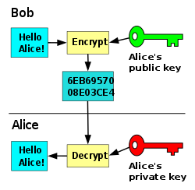
2) Asymmetric-key cryptography / Public Key Cryptography

Slide 124
In Public-key cryptography, where different keys are used for encryption and decryption.
Padlock icon from the Web browsers, which indicates that TLS, a public-key cryptography system, is in use.
A public key system is so constructed that calculation of one key (the 'private key') is computationally infeasible from the other (the 'public key'), even though they are necessarily related.

Slide 125
In public-key cryptosystems, the public key may be freely distributed, while its paired private key must remain secret.
In a public-key encryption system, the public key is used for encryption, while the private or secret key is used for decryption.

Slide 126
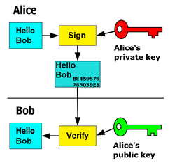
More application of Public-Key cryptosystem: Digital Signature

Slide 127
In this example the message is only signed and not encrypted.
1) Alice signs a message with her private key. 2) Bob can verify that Alice sent the message and that the message has not been modified.
Most public-key algorithms involve operations such as modular multiplication and exponentiation, which are much more computationally expensive.

Slide 128
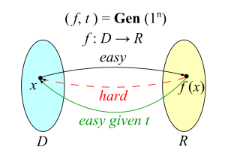
Trapdoor function

Slide 129
A trapdoor function is a function that is easy to compute in one direction, yet difficult to compute in the opposite direction.
An example of a simple mathematical trapdoor is "6895601 is the product of two prime numbers.
To find those numbers, A typical solution would be to try dividing 6895601 by several prime numbers until finding the answer.

Slide 130
End of Unit ‘1’

